Slide 1

Raising climate ambition in 2023 to keep 1.5C within reach
Nate Hultman
Director, Center for Global Sustainability Professor, School of Public Policy
University of Maryland
March 8, 2023

Slide 2



The Center for Global Sustainability Through world-leading research and policy engagement, we change the way that governments, businesses, and people see possibilities for—and implement—ambitious climate action.

Slide 3



CGS is a research center at the University of Maryland supporting global, national, and state climate discussions
Policy Impact. CGS contributes to advancing climate discussions in the U.S., in other countries, globally, and in our State:
US climate goals: CGS has produced analysis supporting, and helped provide input to, the 2025 and 2030 U.S. NDCs; led writing for 2021 U.S. long-term strategy report
U.S.-China climate cooperation: Supported and helped negotiate the U.S.-China Joint Glasgow Declaration at COP27;at COP28 was asked by both the U.S. and Chinese envoys to facilitate experts’ group providing recommendations
USG support: Providing ongoing analysis and input to State Dept. to understand national ambition in 15 key countries, including roughly 75 briefings and other deliverables since 2021
Other Countries: Supporting policy discussions via collaborative research in China, India, Indonesia, Brazil, Maldives, others
State of Maryland: Delivering research to develop and write the State’s plan to achieve its ambitious 2031 and 2045 climate goals.
Research Leadership and Productivity. CGS is running a portfolio of 40 projects and collaborates with 54 research teams in 17 countries. In the past two years, CGS researchers have:
Authored or co-authored 120 peer-reviewed journal articles
Published 150 additional research products, including many large, multi-institution reports, policy briefs, and more;
Developed and made public one global database
The recent report from the Intergovernmental Panel on Climate Change cited 60 papers that were co-authored by CGS
Large and Effective Team. CGS has created an integrated community of nearly 60 people; including 15 full time positions including 12 full time funded faculty; 12 Joint Appointees with our national lab partner institution; 13 part time and other affiliated faculty, and roughly 20 Ph.D. and master’s student research assistants.
Visibility. Global and national research reputation; since 2019 over 230 national and international media hits, including featuring CGS research on the front page of The New York Times and in The Wall Street Journal. And In the past three years, CGS organized 1 major research conference, 12 workshops, 30 external events; and 94 talks.

Slide 4
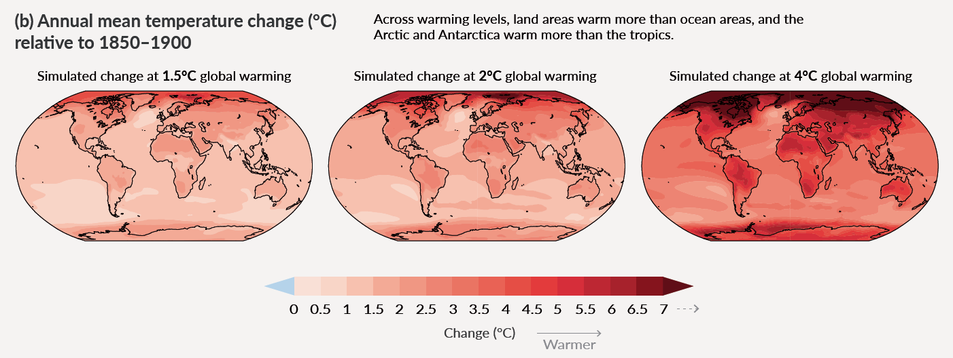

The World’s Question: Can we reach a 1.5-degree C trajectory?
Where are we now and where are we heading?
What are the possible ways to enhance that action?
Source: IPCC WG1 SPM (2021), Humans of Kiritibati COP23 (2017).

Slide 5
An initial framing note: Global climate action and the role of international negotiations
Most power for climate policy resides at national level; some at subnational
International negotiations have value for coordination and leveraging other processes
5-minute history of climate policy from 1896 to the Paris Agreement

Slide 6
An initial framing note: Global climate action and the role of international negotiations
Negotiations have always had two levels: “Big Cop and little cop” (Biniaz)
The Paris Agreement established an architecture of centering the locus of climate action and commitments in actions taken outside of the negotiations
Big Cop becomes more important as a forcing moment, Little cop remains more narrowly important to make sure goals are adjusted as needed and the architecture is sound

Slide 7
The core engine of Paris is the NDC What makes a good climate target?
Is it Ambitious?
Is it Achievable?
…
Is it 1.5-Aligned?
Is it in line with national priorities?
Is it implemented?

Slide 8
What did we get in 2021? Pre-COP26
Enhanced U.S. Action
United States rejoins Paris; U.S. 2030 climate target; new U.S. 2050 net zero goal and long-term strategy; U.S. domestic actions including from Bipartisan Infrastructure Deal from Congress
Enhanced country targets (NDCs) for 2030
with strong contributions from particularly the G7 economies representing 65% of global emissions
A flurry of new 2050 or midcentury net zero goals
Roughly 90% of emissions now covered
Continued expansion of implementation

Slide 9

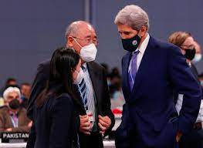
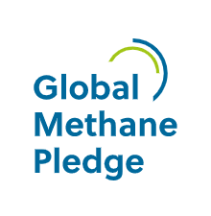
What did we get in 2021? At COP26
Little COP
Language around 1.5
Much attention on “phase out” vs. “phase down”
Mechanisms of Paris including the “Paris Rulebook”
Ratchet: Countries enhance NDCs in 2022
Big COP
Methane
US-China Joint Glasgow Declaration
Forests Declaration, First Movers Coalition, and others
JET-P South Africa

Slide 10

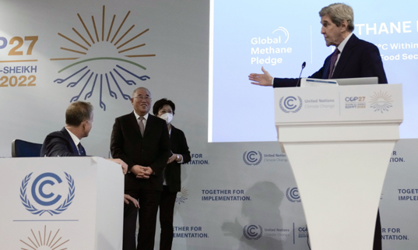
What did we get in 2022? At COP27
Little COP
Agree to establish a fund and work on structure for Loss and Damage
Not much on mitigation
No agreement on phasedown of fossil fuels, and wavering on 1.5
Big COP
Methane +20 countries on GMP
Renewed US-China Conversation
JET-P Indonesia
Mixed narrative going into Global Stocktake

Slide 11
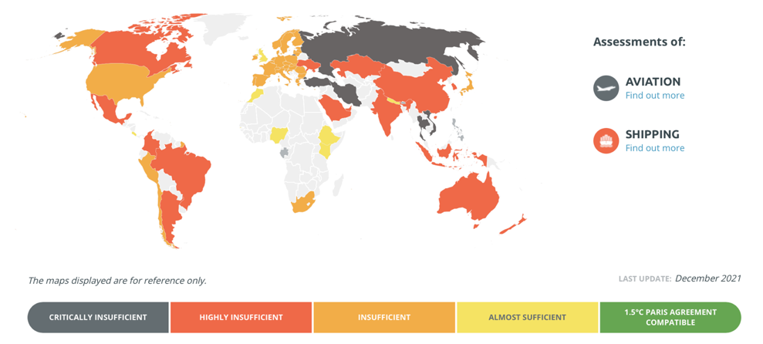
Where does all of that leave us today? Constituting the global picture through NDCs
National targets are diverse in form and ambition
Constructing a 1.5C path depends on the diverse pieces
Enhancing ambition in these “pieces” will be critical in next 1-3 years
Source: Climate Action Tracker (2021)

Slide 12
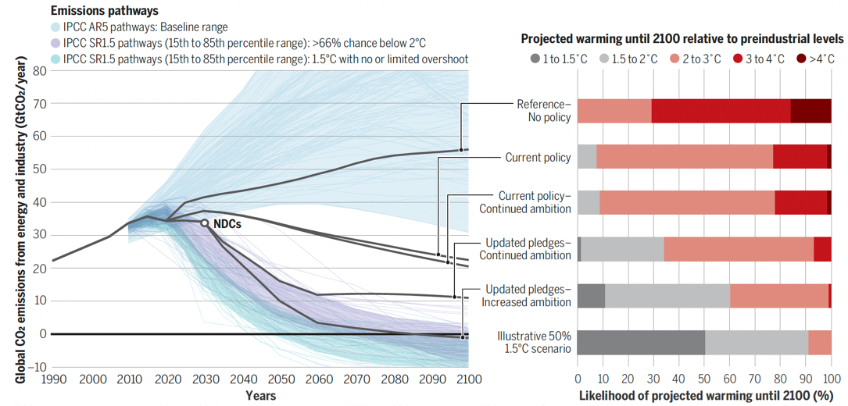

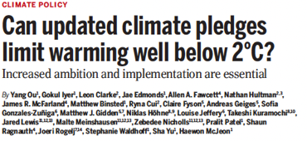
Where does all of that leave us today? The global picture (a)
Source: Ou, Iyer et al. (2021)

Slide 13
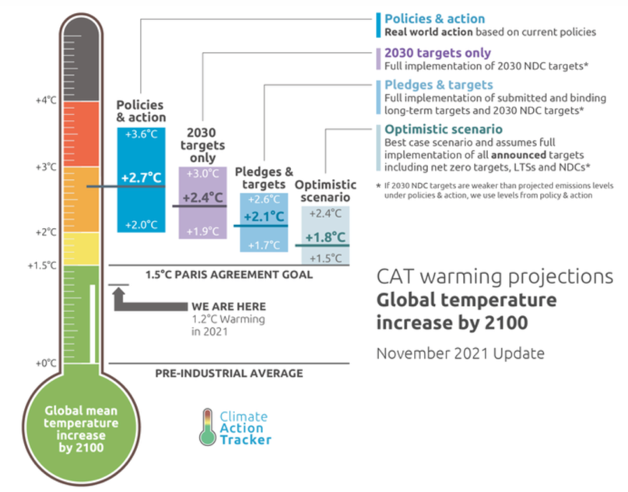
Where does all of that leave us today? The global picture (b)
Three parts of this story
We have made good progress on ambition and action since Pre-Paris
We are not on 1.5 trajectory
Keeping 1.5 “in reach” is still possible, barely
Source: Climate Action Tracker (2021)

Slide 14
What can we expect for 2023?
Year of Global Stocktake
Are we on track to 1.5?
Potential new NDC enhancements
More JETP?

Slide 15
Thank You
Prof. Nate Hultman, Director, Center for Global Sustainability
cgs.umd.edu

Slide 16
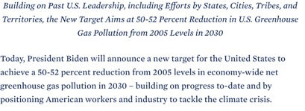
Let’s look at the United States as one example 2030 NDC and Long-Term Climate Strategy
2030: 50-52% reduction in net GHG emissions, relative to 2005
2035: 100% clean electricity
2050: Net zero emissions

Slide 17
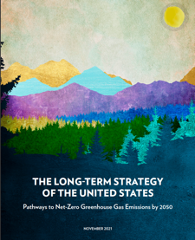
Reaching a Global Net Zero Economy will require integration of near-term economic and development goals, NDCs, and national long-term strategies
Example:
U.S. Long-Term Strategy (2021)

Slide 18
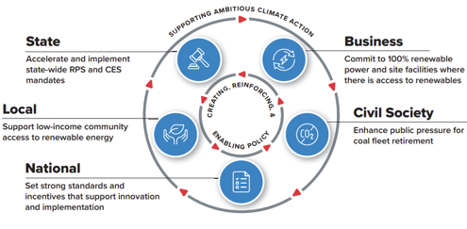
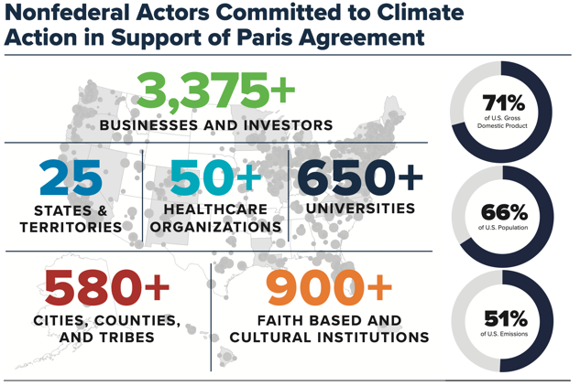
An “All of Society” national climate strategy combines policies at national and subnational levels, as well as actions from private sector and civil society
Every country is different but all have opportunities for diversified climate action
U.S. for example has multiple policy areas that can be complementary and mutually reinforcing
Building policies across all of society has multiple benefits:
Builds support for higher national-level ambition
Builds stronger and more robust long-term politics
Creates learning across more areas more quickly
Provides some flexibility in how to achieve goals across all of economy

Slide 19
Climate Policy in the United States: Overview Three Broad Categories Driving Action in the “All of Society” strategy
1. National Level: Legislation from Congress. This type of action can change tax policy, provide incentives and funding, and set up new regulatory authority.
Clean Air Act
Energy Policy Act
Infrastructure Investment and Jobs Act of 2021
Inflation Reduction Act of 2022
2. National Level: New regulatory actions from the Executive Branch. This type of action is carried out by the Executive Branch agencies (Department of Energy, EPA, Department of Interior, etc.)
Air pollution guidelines that affect CO2 or methane
Leasing on federal lands
3. Subnational Levels. Non-federal government policies and investments from the private sector, among others.
Policies, laws, and regulatory actions from states and cities
Other actions from businesses, investors, and others

Slide 20
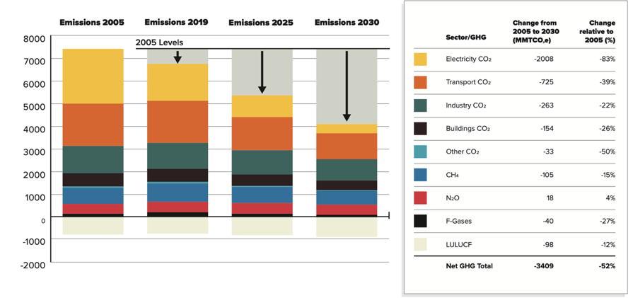
U.S. 2030 goal is achievable with a continuing set of policies and actions that are now being put in place
Ambitious: 50-52% is highly challenging for the U.S. to deliver
Achievable: NDC level is feasible based on assembling significant coalitions and delivering high levels of federal action
1.5 Aligned: The U.S. trajectory is broadly aligned with IPCC 2030 and 2050 global goals. However, depends on approach for allocating across countries and approaches diverge.
Source: Blueprint 2030, AAII with UMD, WRI, RMI (2021)

Slide 21
Connecting the 2030 NDC to 2050 Net Zero
United States Long-Term Strategy
Source: U.S. Long Term Strategy (2021) Available at : https://www.whitehouse.gov/wp-content/uploads/2021/10/US-Long-Term-Strategy.pdf

Slide 22
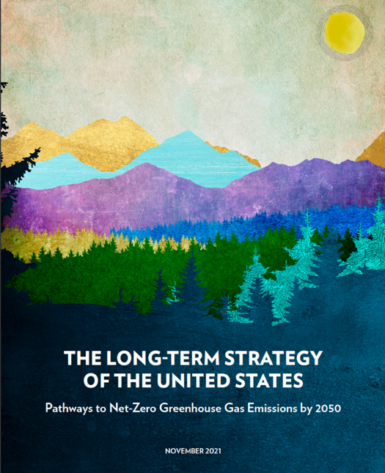
Pathways to 2050 in the United States: Common Elements Across All Scenarios
DECARBONIZE ELECTRICITY. Electricity delivers diverse services to all sectors of the American economy. The transition to a clean electricity system has been accelerating in recent years— driven by plummeting costs for solar and wind technologies, federal and subnational policies, and consumer demand. Building on this success, the United States has set a goal of 100% clean electricity by 2035, a crucial foundation for net-zero emissions no later than 2050.
ELECTRIFY END USES AND SWITCH TO OTHER CLEAN FUELS. We can affordably and efficiently electrify most of the economy, from cars to buildings and industrial processes. In areas where electrification presents technology challenges—for instance aviation, shipping, and some industrial processes— we can prioritize clean fuels like carbon-free hydrogen and sustainable biofuels.
CUT ENERGY WASTE. Moving to cleaner sources of energy is made faster, cheaper, and easier when existing and new technologies use less energy to provide the same or better service. This can be achieved through diverse, proven approaches, ranging from more efficient appliances and the integration of efficiency into new and existing buildings, to sustainable manufacturing processes.
REDUCE METHANE AND OTHER NON-CO2 EMISSIONS. Non-CO2 gases such as methane, hydrofluorocarbons (HFCs), nitrous oxide (N2O), and others, contribute significantly to warming— with methane alone contributing fully half of current net global warming of 1.0°C. The U.S. will also prioritize research and development to unlock the innovation needed for deep emissions reductions beyond currently available technologies.
SCALE UP CO2 REMOVAL. In the three decades to 2050, our emissions from energy production can be brought close to zero, but certain emissions such as non-CO2 from agriculture will be difficult to decarbonize completely by mid-century. Reaching net-zero emissions will therefore require removing carbon dioxide from the atmosphere, using processes and technologies that are rigorously evaluated and validated. This requires scaling up land carbon sinks as well as engineered strategies.

Slide 23
Pathways to Net-Zero in the United States Require Action Across All Sectors and Gases
Source: U.S. Long Term Strategy (2021)

Slide 24
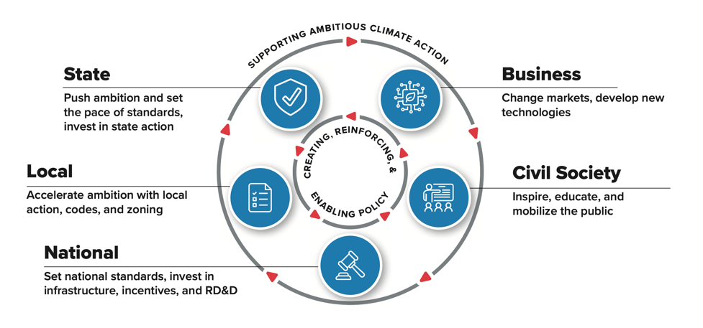
Steps toward Enhancing targets
Building the Politics and Policies
Forcing events
Continuous improvement for NDC s and implementation
Continued need for ”All In” approach to climate policy
2023 Global Stocktake
2024-5 Scheduled Paris update
Domestic calendars provide important overlay for these
Source: Blueprint 2030, AAII with UMD, WRI, RMI (2021)

Slide 25
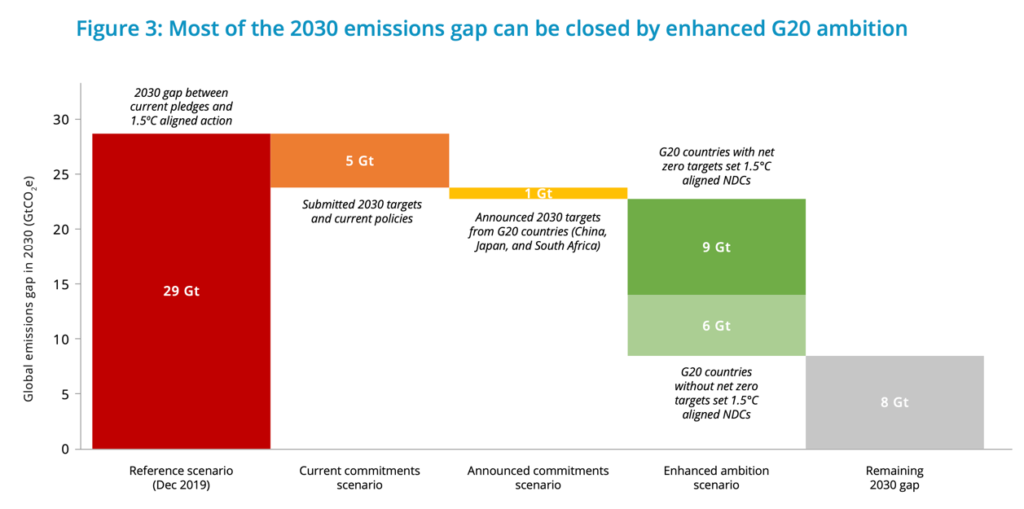
Focusing our effort: G20 Enhancement
If all G20 members align NDCs with a 1.5°C pathway, 2100 warming could be limited to 1.7°C.
With this 0.7°C drop, down from 2.4°C under current commitments, G20 countries could collectively close three-quarters of the temperature gap to 1.5°C, keeping it within reach.
Source: Fyson et al (2021). Closing the Gap: The effect of G20 climate commitments…

